Slide 1
Structure de la présentation
Title, name, supervisors name, semester project, ECTs credits, faculty (microtechnique)
Motivation
Vidéo ou snapshot 3D pour expliquer l’intérêt du projet (certains scan trop lent)
GT + Overlap des mesures (montrer la position des mesures) (bien indiquer les axes)
Poser le problème d’interpolation (f(x,t) = sum c b b etc.), v = Hc -> instable numériquement -> iterative method
-> permet d’utiliser des régularisations R(c), GlobalBioIm, to begin the project with b1
Results of b1: GT, naive, lambda=0, lambda = tmp
Results of b3: GT, naive, lambda=0, lambda = tmp Comparison b1,b3 : GT, b1, b3, b1 - b3 (diff map)
Future directions:
Extension to 2D, 3D + time
Add noise to measurements and assess regularisations effects (Denoising)
Application to real data
Recover the whole function f(x,t) (show example of Gaussian) (orally tell if time permits)

Slide 2
Timing correction for slow-scanning biomedical imaging devices
Semester project: 10 ECTS
Luca Fetz, faculty of microtechnique
Supervisors : Thomas Debarre, Thanh-an PHAM

Slide 3

Motivation
Ca2+ imaging (Bindocci, 2017)

Slide 4
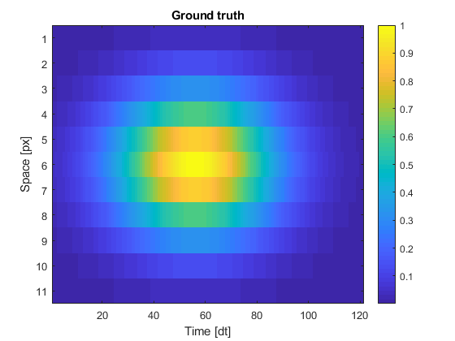
Project goals
Model sampling correctly.
Add timing correction to frames
First step in 1D + time

Slide 5
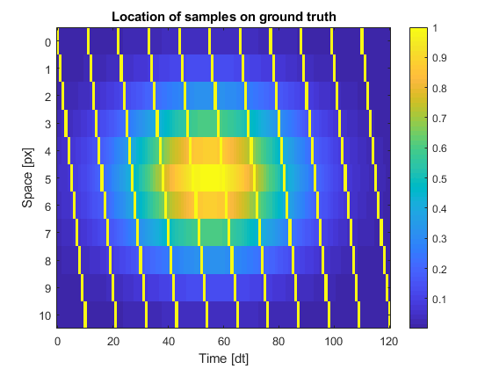
Project goals
Model sampling correctly.
Add timing correction to frames
First step in 1D + time

Slide 6

Usual approximation

Slide 7
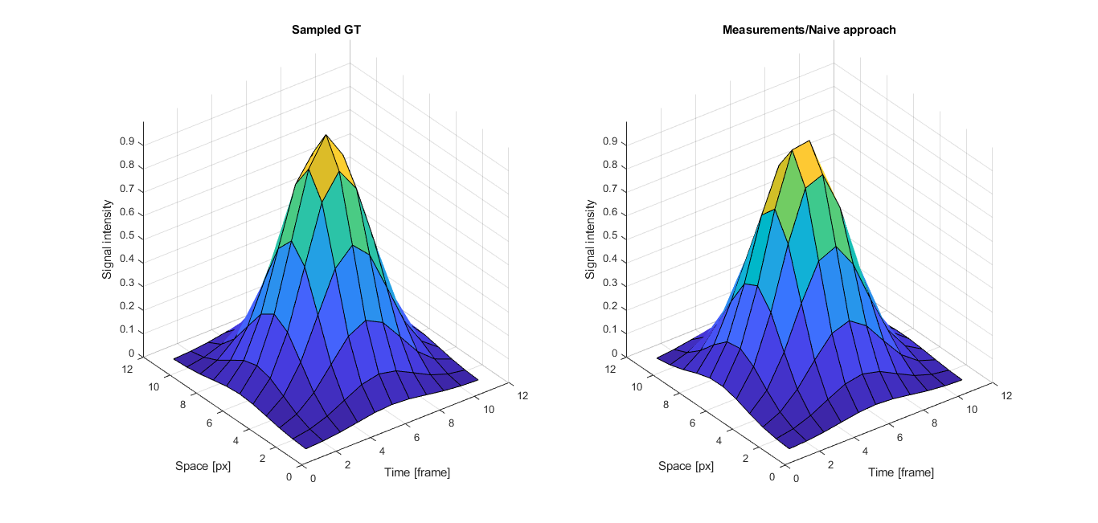
Usual approximation

Slide 8
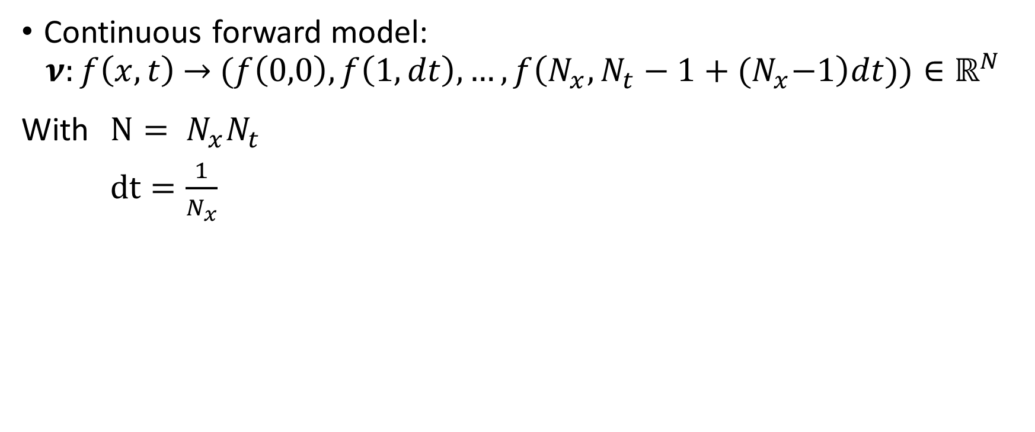
Mathematical model
Continuous forward model:
$$ν:f\left(x,t\right) \overset{→}{ } (f\left(0,0\right),f\left(1,dt\right),…,f\left(N_{x},N_{t}−1+{(N}_{x}−1\right)dt))∈ℝ^{N}$$
With $N= N_{x}N_{t}$
$dt=\frac{1}{N_{x}}$

Slide 9
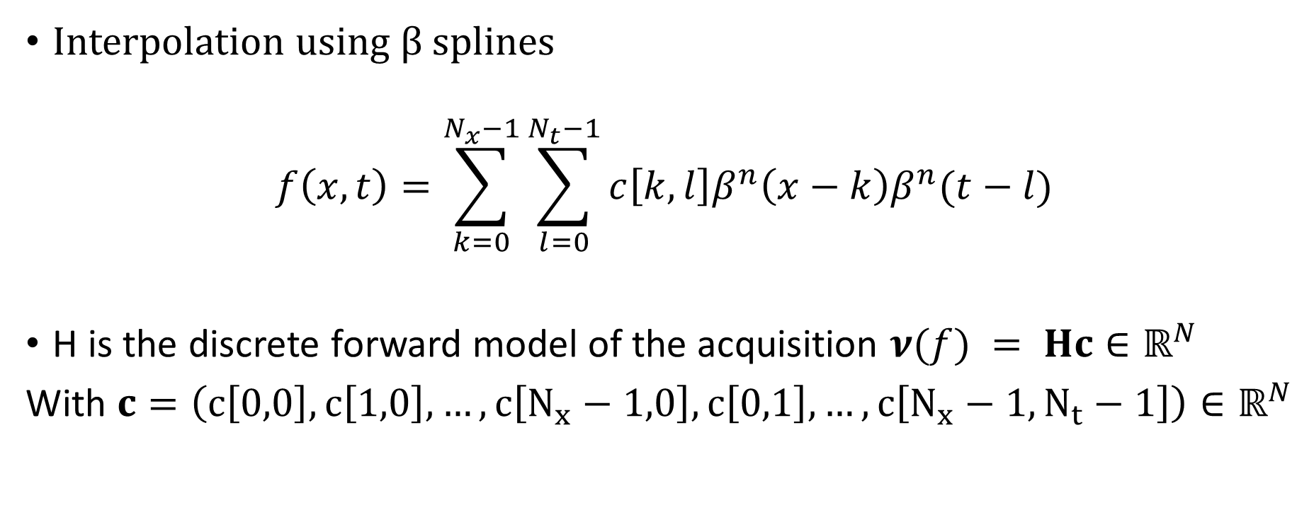
Mathematical model
Interpolation using $β$ splines
$$f\left(x,t\right)=\sum_{k=0}^{N_{x}−1}{\sum_{l=0}^{N_{t}−1}{c\left[k,l\right]β^{n}\left(x−k\right)β^{n}(t−l)}}$$
H is the discrete forward model of the acquisition $ν(f) = Hc∈ℝ^{N}$
With $c=\left(c\left[0,0\right],c\left[1,0\right],…,c\left[N_{x}−1,0\right],c\left[0,1\right],…,c\left[N_{x}−1, N_{t}−1\right]\right)∈ℝ^{N}$

Slide 10
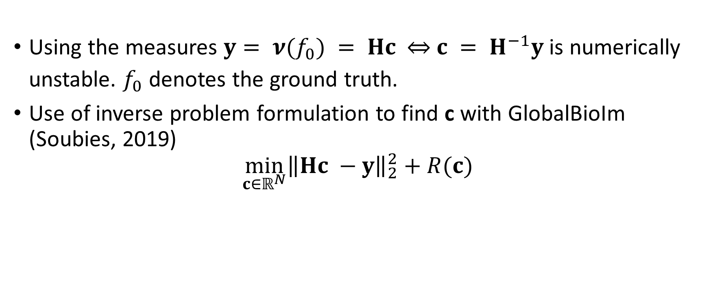
Mathematical model
Using the measures $y= ν(f_{0}) = Hc$ $\overset{⇔}{ } c = H^{−1}y$is numerically unstable. $f_{0}$ denotes the ground truth.
Use of inverse problem formulation to find c with GlobalBioIm (Soubies, 2019)
$$\min_{c∈ℝ^{N}}{{\left\|Hc −y\right\|}_{2}^{2}+R(c)}$$

Slide 11
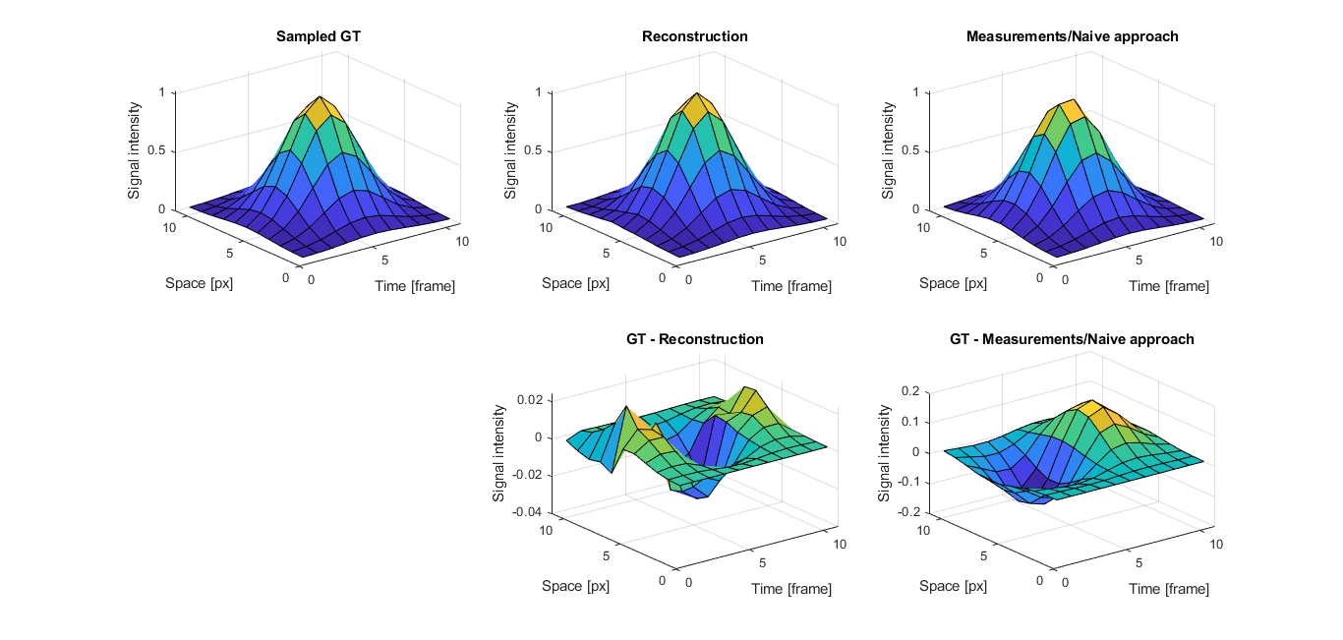
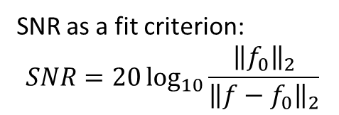
First results: linear spline (n=1)
SNR as a fit criterion:
$$SNR=20\log_{10}{\frac{{\left\|f_{0}\right\|}_{2}}{{\left\|f−f_{0}\right\|}_{2}}}$$
SNR = 30.85 dB
SNR = 15.59 dB

Slide 12
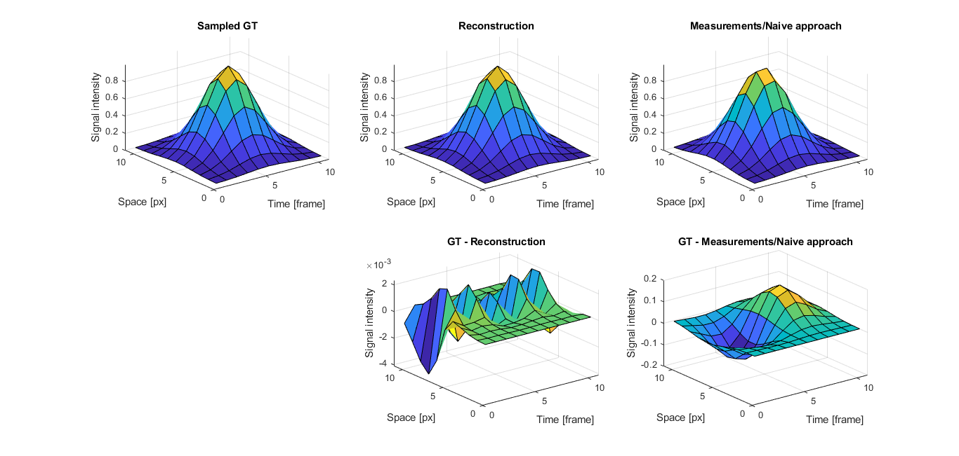
First results: cubic spline (n= 3)
SNR = 49.53 dB
SNR = 15.59 dB

Slide 13
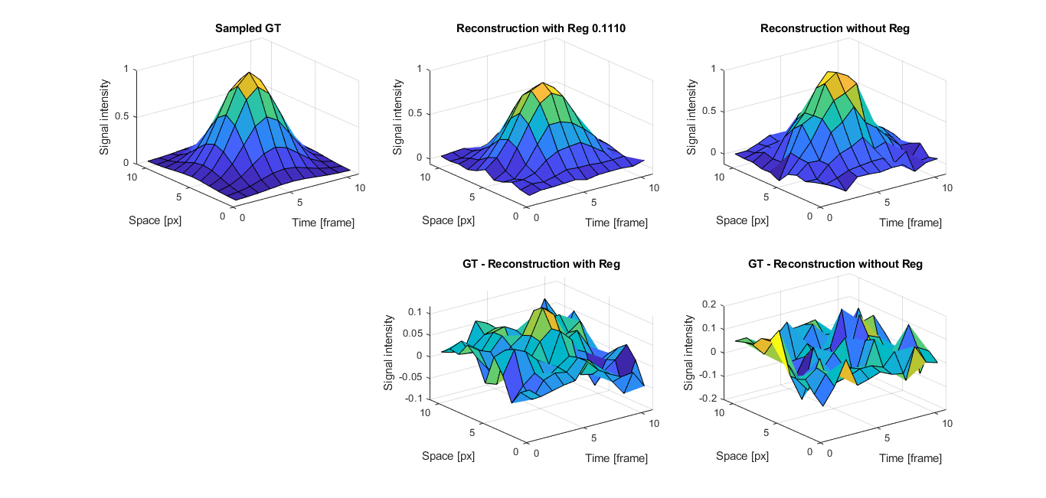
Effect of regularization
When applying noise on measurements (here white gaussian noise of snr = 15dB), regularization proves useful.
SNR = 18.54 dB
SNR = 12.31 dB

Slide 14
Future directions
Extension to 2D + time, 3D + time
Add noise to measurements and assess regularizations effects (Denoising)
Application to real data
Deconvolution?

Slide 15
References
Bindocci, 2017: Three-dimensional Ca2+ imaging advances understanding of astrocyte biology.
Soubies, 2019: Pocket Guide to Solve Inverse Problems with GlobalBioIm

